Slide 1

DATABASE MANAGEMENT SYSTEM
Orderby, Groupby & Aggregate Functions
Lab 2

Slide 2
List Operator
The IN list operator checks if the result of the expression meets one of the specified values.
The syntax for using a list operator in a query is:
SELECT column_name(s) FROM table_name WHERE column_name IN (value1,value2,...);

Slide 3
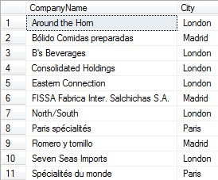
List Operator
SELECT CompanyName,City FROM Customers WHERE City IN ('London','Madrid','Paris')

Slide 4
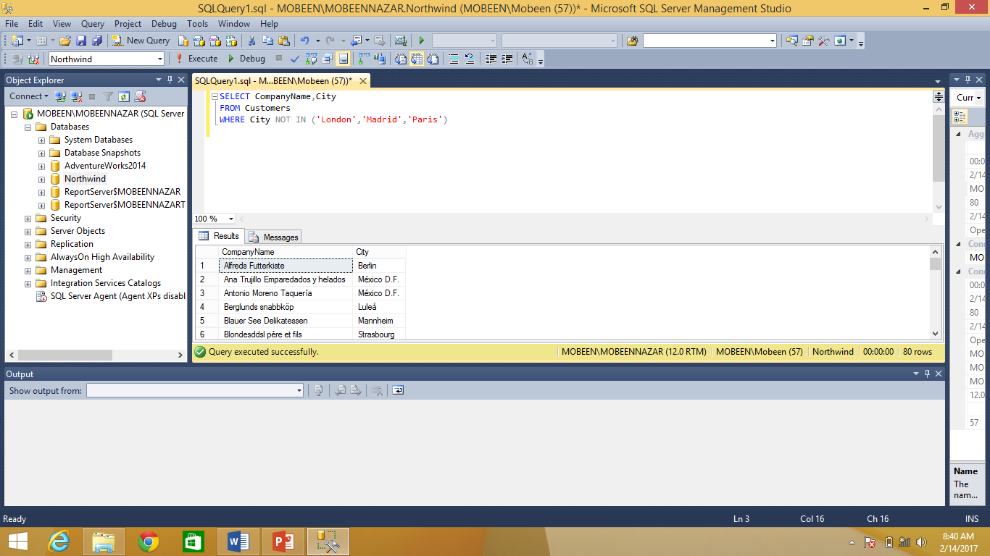
List Operator
SELECT CompanyName,City FROM Customers WHERE City NOT IN ('London','Madrid','Paris')

Slide 5

Between Operator
SELECT EmployeeID, FirstName, LastName, HireDate, City FROM Employees WHERE HireDate BETWEEN '1-june-1992' AND '15december-1993‘

Slide 6
Null Clause
A NULL value in a column means that there is no data in the column. You can retrieve rows which contain NULL values using the IS NULL keyword with the WHERE clause.
SELECT <column_names>
FROM <table_name>
WHERE <column_name> IS NULL

Slide 7
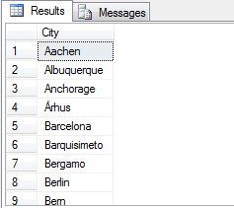
SELECT DISTINCT Statement
The SELECT DISTINCT statement is used to return only distinct (different) values.
SELECT DISTINCT column_name,column_name
FROM table_name;
SELECT DISTINCT City FROM Customers;

Slide 8
Between Operator (REGION OPERATOR)
Note that SQL also has a special BETWEEN operator that checks to see if a value is between two values (including equality on both ends).
Retrieves rows where the tested value falls within the specified range.

Slide 9
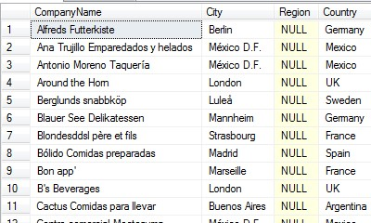
NULL KEYWORD
SELECT CompanyName,City,Region,Country FROM
Customers WHERE REGION IS NULL

Slide 10
SQL Wildcards
A wildcard character can be used to substitute for any other character(s) in a string.
In SQL, wildcard characters are used with the SQL LIKE operator.
SQL wildcards are used to search for data within a table.

Slide 11
SQL Wildcards
Wildcard | Description
_ (underscore) | matches any single character
% | matches a string of one or more characters
[ ] | matches any single character within the specified range (e.g. [a-f]) or set (e.g. [abcdef]).
[^] | matches any single character not within the specified range (e.g. [^a-f]) or set (e.g. [^abcdef]).

Slide 12
SQL Wildcards
SELECT * FROM Customers WHERE City LIKE '_erlin';

Slide 13
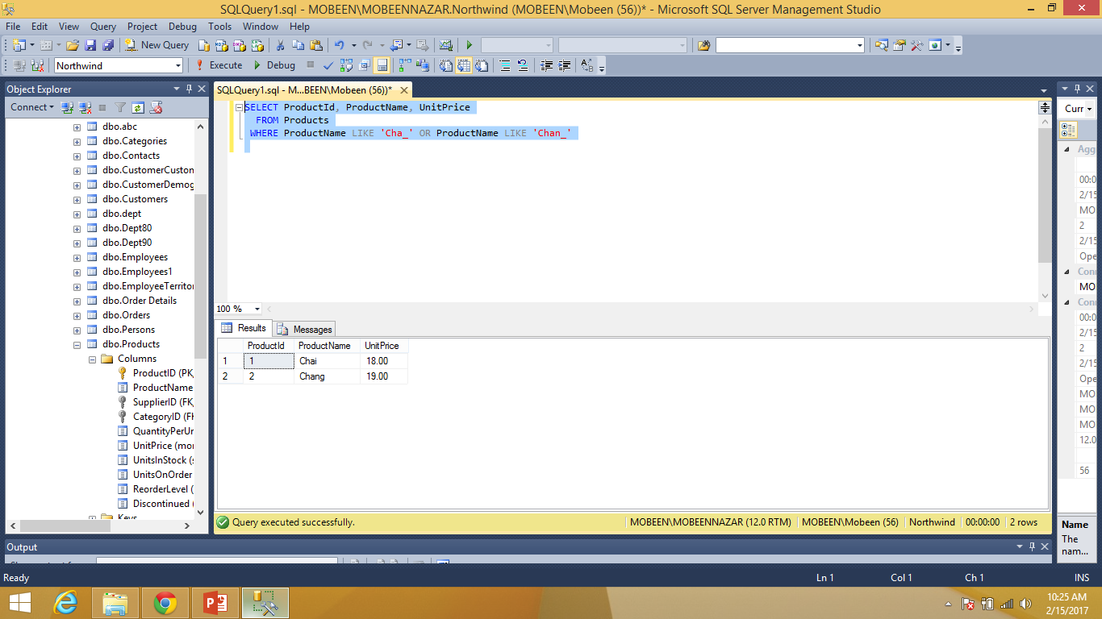
SQL Wildcards
SELECT ProductId, ProductName, UnitPrice FROM Products WHERE ProductName LIKE 'Cha_' OR ProductName LIKE 'Chan_'

Slide 14
ORDER BY
The ORDER BY clause sorts the retrieved results in the ascending or descending order of the values in the specified columns. The ASC and DESC keywords specify the sort order. If the sort order is not specified, the results are sorted in the ascending order.

Slide 15
ORDER BY SYNTAX
SELECT <column_names> FROM <table_name>
ORDER BY <column_name1 [ASC|DESC] >

Slide 16
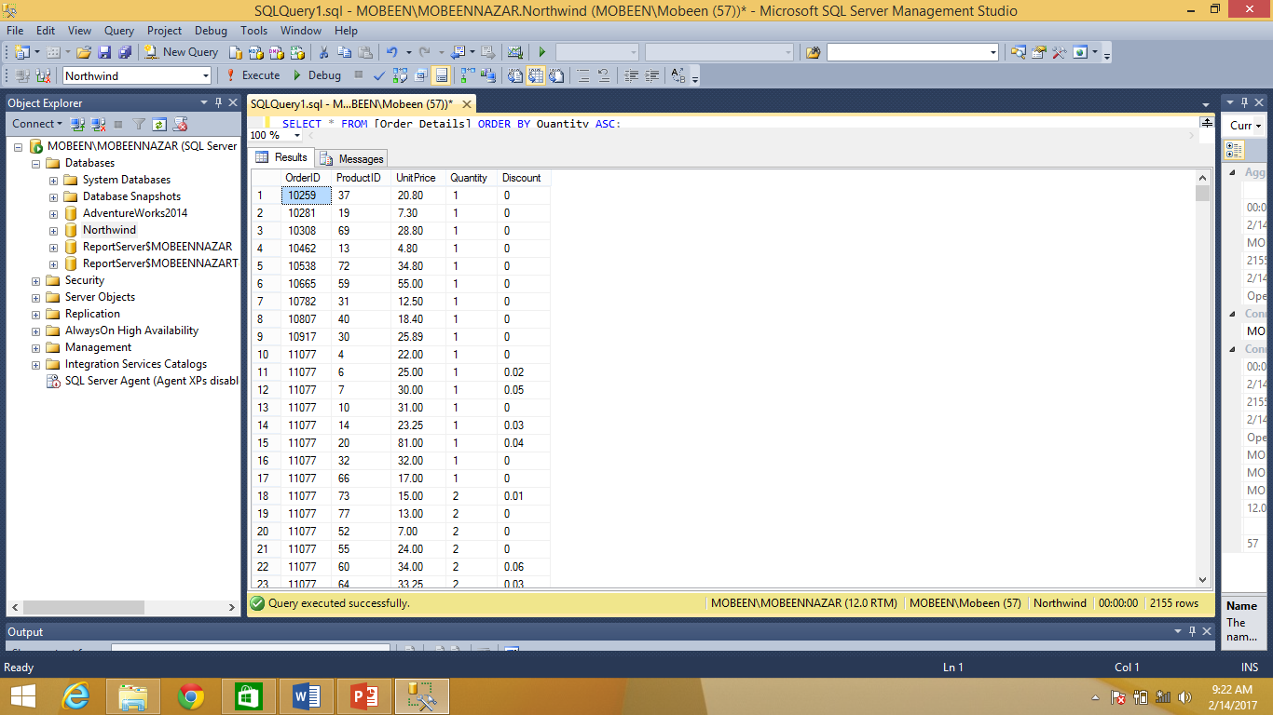
ORDER BY
SELECT * FROM [Order Details] ORDER BY Quantity ASC;

Slide 17
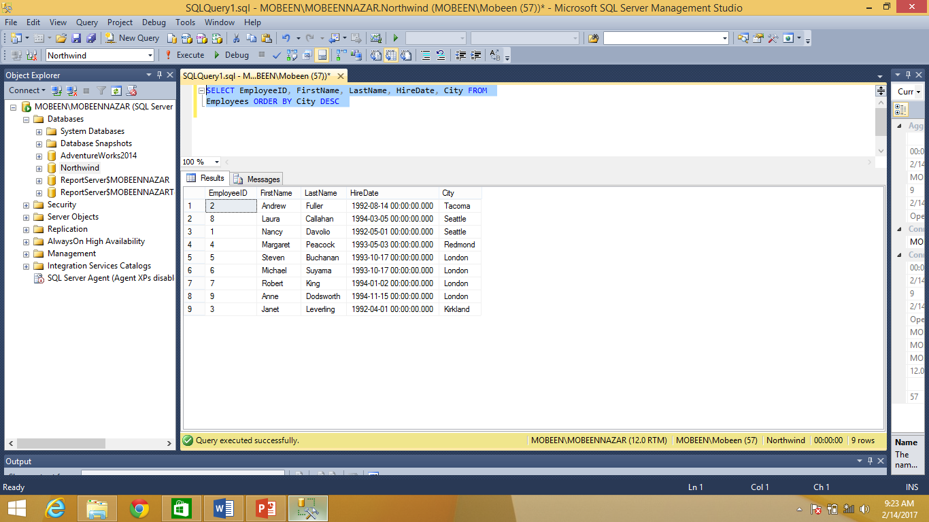
ORDER BY
SELECT EmployeeID, FirstName, LastName, HireDate, City FROM Employees ORDER BY City DESC

Slide 18
SQL AGGREGATE FUNCTION
SQL aggregate functions return a single value, calculated from values in a column.
Useful aggregate functions:
AVG() - Returns the average value
COUNT() - Returns the number of rows
MAX() - Returns the largest value
MIN() - Returns the smallest value
SUM()- Returns the sum

Slide 19
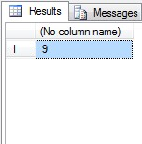
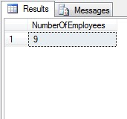
The COUNT() function
The COUNT() function returns the number of rows that matches a specified criteria.
Select COUNT(EmployeeID) from Employees;
Select COUNT(EmployeeID) AS NumberOfEmployees from Employees;

Slide 20
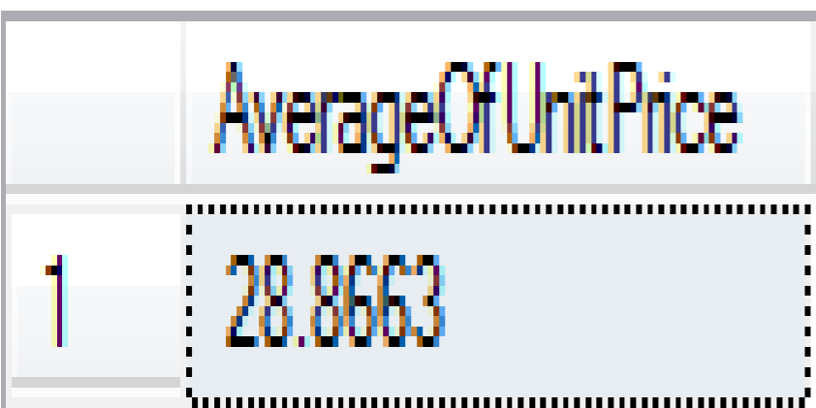
SQL AGGREGATE FUNCTION
Select AVG(UnitPrice) AS AverageOfUnitPrice from Products;

Slide 21

SQL AGGREGATE FUNCTION
Select AVG(DISTINCT UnitPrice)AS
AverageOfUnitPrice from Products;

Slide 22
SQL AGGREGATE FUNCTION
Select SUM(UnitPrice) AS TotalUnitPrice from Products;
Select SUM(Freight) AS TotalFreight from Orders;

Slide 23
SQL AGGREGATE FUNCTION
Select MAX(UnitPrice)from Products;
Select MIN(UnitPrice)from Products;

Slide 24
SQL GROUP BY
The SQL GROUP BY statement is used along with the SQL aggregate functions to provide means of grouping the result dataset by certain database table column(s).

Slide 25
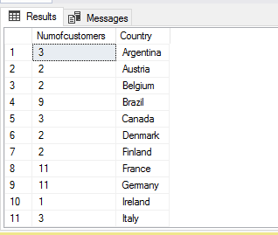
SQL GROUP BY
SELECT COUNT(CustomerID) as Numofcustomers, Country
FROM Customers
GROUP BY Country;

Slide 26

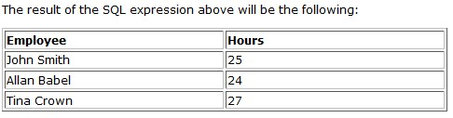
SQL GROUP BY

Slide 27
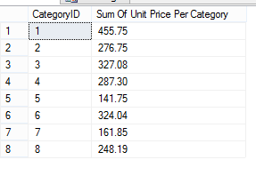
SQL GROUP BY
SELECT CategoryID, SUM (UnitPrice)AS SumOfUnitPrice FROM Products GROUP BY CategoryID;

Slide 28
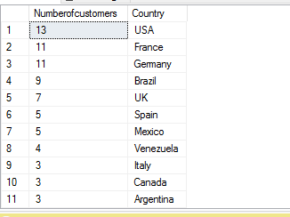
SQL GROUP BY AND ORDER BY
SELECT COUNT(CustomerID) as Numofcustomers, Country
FROM Customers
GROUP BY Country
ORDER BY COUNT(CustomerID) DESC;

Slide 29
SQL HAVING CLAUSE
The HAVING clause was added to SQL because the WHERE keyword could not be used with aggregate functions.

Slide 30
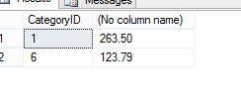
SQL GROUP BY WITH HAVING CLAUSE
SELECT CategoryID, MAX (UnitPrice) FROM Products GROUP BY CategoryID having MAX (UnitPrice)>90;

Slide 31
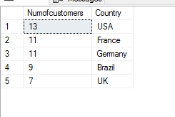

SQL GROUPBY , ORDER BY & HAVING

Slide 32
LAB TASKS
Get the price of an order (by multiplying unit price by quantity).
Display all cities that employees belong to but don’t allow repetition.
Find complete name of all employees.
List the name of all employees whose first name starts with the letter ‘A’.
In Customer table, display all cities that ends with the letter ‘a’.
Display names of all employees whose name contain ‘an’.
Display all the orders where unit price lies in the range of 10$ to 40$.
Display the company name where Region is NULL in Customer Table.
Write a query to list employees whose address does not contain Rd.
List all products where UnitPrice is not in 10,12,15,17 or 19

Slide 33
LAB TASKS
11. Display the highest, lowest, sum and average UnitPrice of each Category, where highest UnitPrice lies in the range of 50$ to 100$. Label column as CategoryId, Maximum, Minimum, Sum and Average, respectively. (Table: Products)
12. From customers table, Count all customers is each region where region is not null. (Table: Customers)
13. Write a query to display the number of ContactName with same ContactTitle. Sort contact title in descending order. (Table: Customers)
14. Write a query that count all orders against each product id. No of orders should be greater than 50. (Table: [Order Details])
15.List only those cities in which more than or equals to 2 employees are living

